Slide 1
Indian Banking Transaction & Fraud Analytics Dashboard
Name : Monika Balasubramani
Batch Code : ANP-D6580
AF ID : AF05304591

Slide 2
Introduction
Banking generates a huge volume of transaction data.
Manual analysis of transaction data is time-consuming.
Fraudulent transactions need to be identified and monitored.
Power BI can transform raw banking data into interactive visual insights.
This project focuses on transaction performance and fraud analysis.
Different factors such as transaction type, bank, device, network and time can influence transaction patterns.
Analyzing these factors helps in understanding successful, failed and suspicious transactions.

Slide 3
Problem Statement & Objectives
Problem Statement
  To develop an interactive Power BI dashboard that analyzes Indian banking transactions, identifies transaction patterns, and provides insights into fraudulent activities and associated risks.
Objectives
  Analyze transaction volume and value.
  Study transaction status and channels.
  Analyze banks, merchants and transaction patterns.
  Identify fraudulent transactions.
  Present insights through interactive dashboards.

Slide 4
Target Viewers
Banking & Financial Institutions
  Monitor transaction activity.
  Analyze transaction performance.
Fraud & Risk Teams
  Analyze fraud patterns based on available transaction attributes.
  Identify areas requiring further investigation.
Data Analysts
  Explore transaction trends and patterns.
  Generate data-driven insights.
Bank Management
  Get a summarized view of transaction performance.
  Support data-based monitoring and decision-making.

Slide 5
Dataset Details
Dataset Name
  Indian Banking Transactions
Dataset Overview
  Total Records: 5,50,000 transactions
  Data Type: Structured transactional data
  Domain: Banking & Digital Transactions
  Source: Kaggle
  Format: Tabular dataset
  Purpose: To analyze transaction behavior, banking activity and fraudulent transactions.

Slide 6
Data Cleaning & Preprocessing
Checked the dataset for missing values.
Removed or handled duplicate records.
Corrected data types for numerical, text and date/time columns.
Standardized categorical values such as transaction type, bank and device type.
Checked transaction amounts for invalid or inconsistent values.
Extracted useful time information such as hour, day and weekend status.
Verified the Fraud Flag values for fraud analysis.
Renamed columns where necessary for easier understanding.
Loaded the cleaned dataset into Power BI for visualization.

Slide 7
Tools & Technologies
Power BI
  Used to create the interactive three-page dashboard.
  Used charts, cards, slicers and other visualizations.
  Used to analyze transaction and fraud-related patterns.
  Helped present the results in an easy-to-understand visual format.
Power Query
  Used for data cleaning and preprocessing.
  Handled missing and duplicate data.
  Corrected data types and standardized values.
  Prepared the dataset before loading it into Power BI.

Slide 8
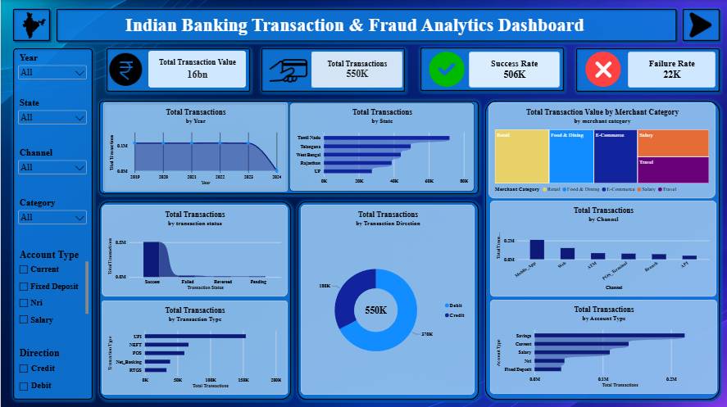
Dashboard Page 1: Transaction Overview

Slide 9
Dashboard – Page 1: Transaction Overview
Purpose:
  Provides an overall view of banking transaction activity and allows users to filter and analyze transactions interactively.
Key Features:
  KPI Cards: Displays Total Transaction Value, Total Transactions, Success Rate and Failure Rate.
  Year & State Analysis: Shows transaction trends over time and transaction volume across states.
  Merchant Category: Compares transaction value across different merchant categories.
  Transaction Status: Analyzes successful, failed, reversed and pending transactions.
  Transaction Direction: Shows the distribution of Debit and Credit transactions.
  Channel Analysis: Compares transactions across channels such as Mobile App, ATM, POS Terminal, Banking and UPI.
  Transaction & Account Type: Provides insights into transaction types and customer account types.
  Interactive Filters: Year, State, Channel, Category, Account Type and Direction can be used to filter the dashboard.

Slide 10
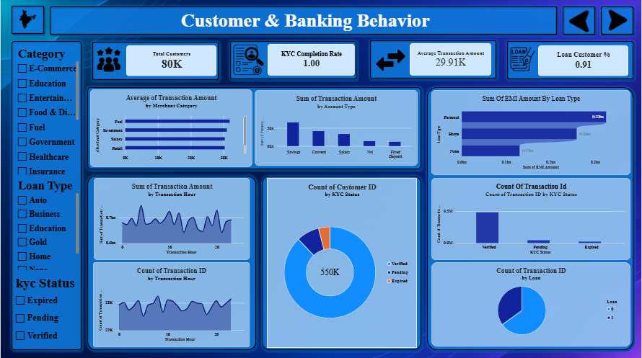
Dashboard Page 2:Customer & Banking Behavior

Slide 11
Dashboard – Page 2: Customer & Banking Behavior
Key Features
  KPI Cards: Shows Total Customers, KYC Completion Rate, Average Transaction Amount and Loan Customer Percentage.
  Merchant Category Analysis: Compares the average transaction amount across different merchant categories.
  Account Type Analysis: Shows the total transaction amount by different account types.
  Loan Analysis: Compares EMI amounts across different loan types.
  Hourly Analysis: Displays transaction amount and transaction count across different hours of the day.
  KYC Status Analysis: Shows the distribution of customers and transactions based on Verified, Pending and Expired KYC status.
  Loan Customer Analysis: Shows the distribution of customers based on whether they have a loan.
  Interactive Filters: Allows users to filter the dashboard by Category, Loan Type and KYC Status.

Slide 12
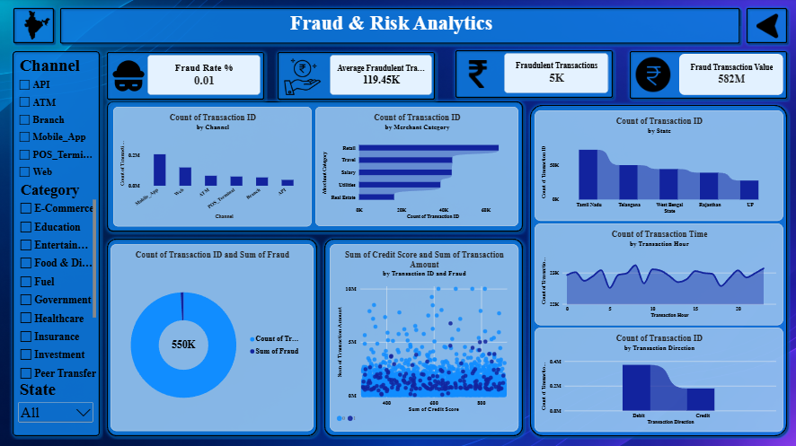
Dashboard Page 3: Fraud & Risk Analytics

Slide 13
Dashboard – Page 3: Fraud & Risk Analytics Overview
Key Features
  Fraud Rate: Displays the percentage of transactions identified as fraudulent.
  Fraudulent Transactions: Shows the total number of transactions flagged as fraud.
  Average Fraudulent Transaction: Provides the average transaction amount associated with fraudulent transactions.
  Fraud & Risk KPI: Provides an additional indicator to understand the level of transaction risk.
  Fraud Pattern Analysis: Helps analyze fraudulent activity across available transaction attributes.
  Bank & Transaction Analysis: Allows comparison of fraud-related activity across banking and transaction categories.
  Interactive Filters: Enables users to explore fraud patterns based on relevant categories such as bank, device, network or transaction characteristics.

Slide 14
Overall Key Findings
Key Findings
  The dashboard provides an overall view of 5.5 lakh banking transactions and their transaction values.
  Transaction activity can be analyzed based on state, channel, merchant category and transaction type.
  The dashboard shows differences in transaction behavior across account types and customer categories.
  Customer and banking behavior can be studied using transaction amount, loan type and KYC status.
  Hour-wise analysis helps identify patterns in transaction amount and transaction volume.
  Fraud-related analysis helps identify fraudulent transactions and potential risk patterns.
  Interactive filters allow users to explore the data based on different categories and conditions.

Slide 15
Conclusion & Future Scope
Conclusion
  The project successfully transforms raw banking transaction data into an interactive Power BI dashboard.
  Power Query was used to clean and prepare the dataset before analysis.
  The three dashboard pages provide insights into transaction activity, customer behavior and fraud-related patterns.
  Interactive visuals and filters make it easier to explore and understand banking data.
  The dashboard can support data-driven monitoring and analysis of banking transactions
Future Scope
  Integration with real-time banking transaction data.
  Implementation of machine learning models for fraud prediction.
  Development of real-time fraud alerts for suspicious transactions.

Slide 16
Thank you

